Slide 1
Software Project Estimation (wideband Delphi estimation technique)

Slide 2
What is Project Estimation?
How much will the project take in terms of time, cost, money and manpower?
For example, if we are designing a system . Following needs to be answered first,
How many developers are needed?
How many months will it take?
What will be total project cist?
What tools or infrastructure is needed?
After that project manager put forward the proposal for acceptance.

Slide 3
Need for Project Estimation
Budget planning
Time scheduling
Resource allocation
Risk management
Stake holders’ communication
Project feasibility analysis

Slide 4
Need for Project Estimation
Let’s say a team is building an LMS:
Without estimation,
Deadlines might be unrealistic
Budget may exceed its limits
Team might be insufficient
With estimation
Effort=1200 person-hours (1 person working for an hours)
Duration = 4months
Cost= PKR 1,200,000
Team = 4 developers + 1 tester
Now, planning is structured and controlled.

Slide 5
Estimation techniques
COCOMO
Wideband delphi estimation
Functional points estimation
LOC estimation

Slide 6
For good estimation, following are needed:
WBS
deliverables
A clear effort estimation for each task
A list of assumptions which were necessary for making the estimate
Consensus among the project team that the estimate is accurate

Slide 7
Assumptions Make Estimates More Accurate
Team members make assumptions about the work to be done to deal with incomplete information
Must estimate the issues needed to make decision
Assumptions must be written down so that if they prove to be incorrect then it must be back tracked and corrected.

Slide 8
Wideband Delphi
Wideband Delphi is a process that a team can use to generate an estimate
The project manager chooses an estimation team,
and gains consensus among that team on the results.
Wideband Delphi is a repeatable estimation process because it consists of a straightforward set of steps that can be performed the same way each time

Slide 9
Delphi Technique
Take inputs from multiple stake holders
Create final estimate on that
Steps followed:
Must have a facilitator/coordinator
Create list of experts
Create 3-5 questions
For example what's better to use for project? Azure / AWS etc..….
Reach to all the results
Analyze & iterate

Slide 10
The Wideband Delphi Process
Step 1: Choose the team
The project manager selects the estimation team and a moderator. The team should consist of 3 to 7 project team members.
The moderator should be familiar with the Delphi process, but should not have a stake in the outcome of the session if possible.
If possible, the project manager should not be the moderator because he should ideally be part of the estimation team.

Slide 11
The Wideband Delphi Process
Step 2: Kickoff Meeting
The project manager must make sure that each team member understands the Delphi process, has read the vision and scope document and any other documentation, and is familiar with the project background and needs.
The team brainstorms and writes down assumptions.
The team has the generated WBS.
The team agrees on a unit of estimation.

Slide 12
The Wideband Delphi Process
Step 3: Individual Preparation
Each team member independently generates a set of preparation results.
For each task, the team member writes down an estimate for the effort required to complete the task,
and any additional assumptions he needed to make in order to generate the estimate.

Slide 13
The Wideband Delphi Process
Step 4: Estimation Session
During the estimation session, the team comes to a consensus on the effort required for each task in the WBS.
Each team member fills out an estimation form which contains his estimates.
The rest of the estimation session is divided into rounds during which each estimation team member revises her estimates based on a group discussion. Individual numbers are not discussed.

Slide 14
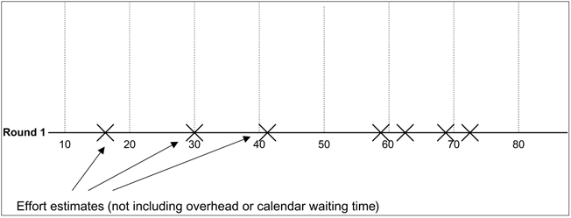
The Wideband Delphi Process
Step 4: Estimation Session (continued)
The moderator collects the estimation forms and plots the sum of the effort from each form on a line:

Slide 15
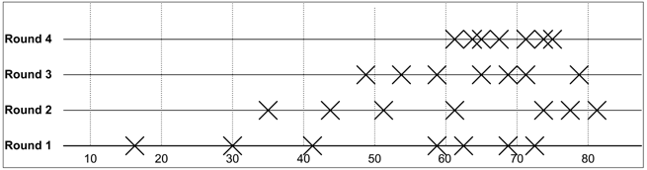
The Wideband Delphi Process
Step 4: Estimation Session (continued)
The team resolves any issues or disagreements that are brought up.
Individual estimate times are not discussed. These disagreements are usually about the tasks themselves. Disagreements are often resolved by adding assumptions.
The estimators all revise their individual estimates. The moderator updates the plot with the new total:
Goal: to achieve the max Convergence.

Slide 16
The Wideband Delphi Process
Step 4: Estimation Session (continued):
The moderator leads the team through several rounds of estimates to gain consensus on the estimates. The estimation session continues until the estimates converge or the team is unwilling to revise estimates.
Delta sheet could also be formed by showing the variation in estimates after a round.
Step 5: Assemble Tasks
The project manager works with the team to collect the estimates from the team members at the end of the meeting and compiles the final task list, estimates and assumptions.
Step 6: Review Results
The project manager reviews the final task list with the estimation team.

Slide 17
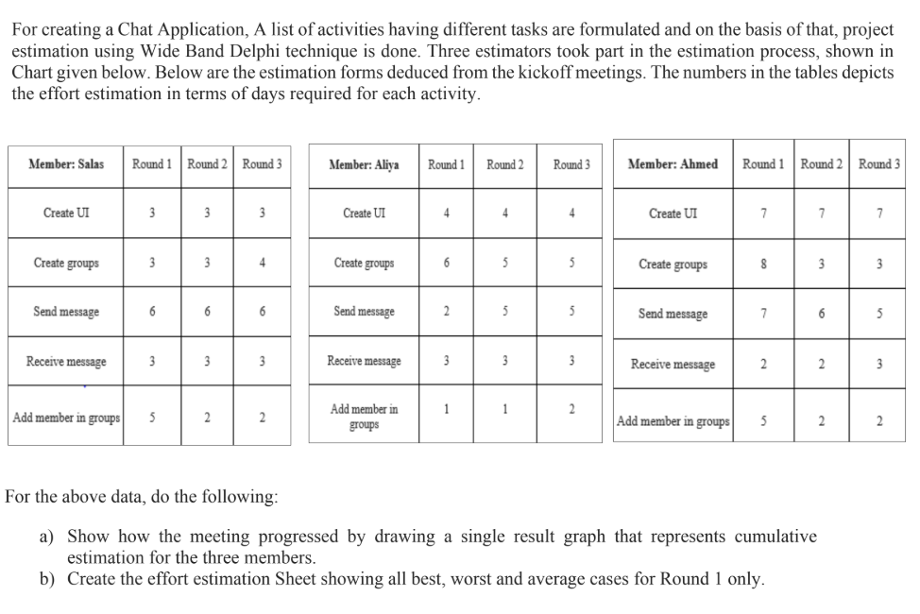
Case study

Slide 18
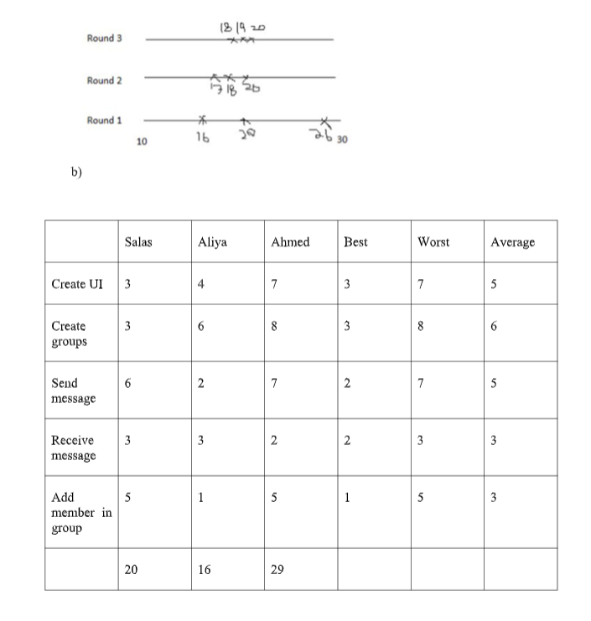
Solution

